Slide 1
A REAL-WORLD LOGISTICS ANALOGY
HTTP, REST & Status Codes
The delivery truck, the warehouse shipping rules, and the final tracking receipt.

Slide 2


The Three Pillars of Delivery
HTTP: The Vehicle
REST: The Rules
Status: The Receipt
Moves packages along physical highways.
Standardized addresses and barcodes.
Instant 3-digit tracking updates.

Slide 3


SPEAKER 1 · TRANSPORT MECHANISM
HTTP: The Truck & Driver
Highway Courier Operations
Physical Highway: Bridges client doorstep and central warehouse.
Action Verbs: Driver obeys standard dispatch instructions.
Cargo Payload: Holds order requests inside the truck bed.

Slide 4

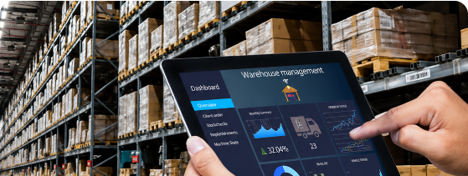
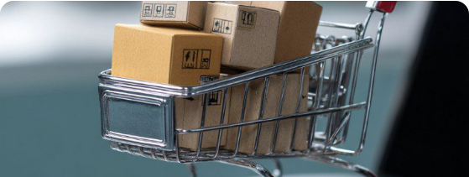
SPEAKER 1 · CRUD IN LOGISTICS (PART A)
Read & Create: GET & POST
GET · READ
POST · CREATE
View Products
Add to Cart
Inspect catalog through driver window.
Drop new order package into truck bed.

Slide 5

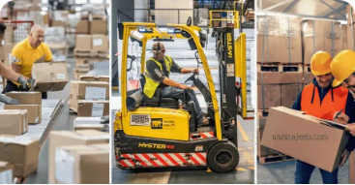

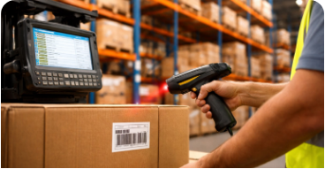

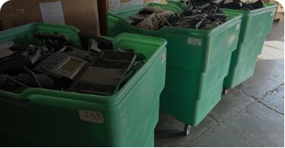
SPEAKER 1 · CRUD IN LOGISTICS (PART B)
Update & Delete: PUT, PATCH & DELETE
PUT · REPLACE
PATCH · MODIFY
DELETE · REMOVE
Complete Box Swap
Change Quantity
Remove Item
Replace entire pallet at bay slot.
Paste revision sticker on box label.
Discard scrap parcel from manifest.

Slide 6

SPEAKER 1 · WAREHOUSE ARCHITECTURE
REST is Stateless: The Shipping Label Sample
EXPRESS PARCEL WAYBILL
STATELESS
TRACKING: REST-REQ-9842-TX
The Barcode Rule
Driver Amnesia: Couriers hold zero trip memory.
* POST /api/cart *
Self-Contained Parcel: Label holds address, token, and payload.
DESTINATION (URI):
/v1/warehouse/orders
INSTRUCTION:
POST (Drop Off New Order)
Any Driver Fulfills: Every request stands alone completely.
SECURITY KEY:
Bearer eyJhbGciOi...
PARCEL CARGO:
{"item": "Running Shoes", "qty": 1}

Slide 7
SPEAKER 1 · FLEET EFFICIENCY
Why Stateless Logistics Scales
0 KB
100%
Zero
Driver memory overhead per client.
Interchangeable drivers across fleet.
Downtime during route breakdowns.

Slide 8

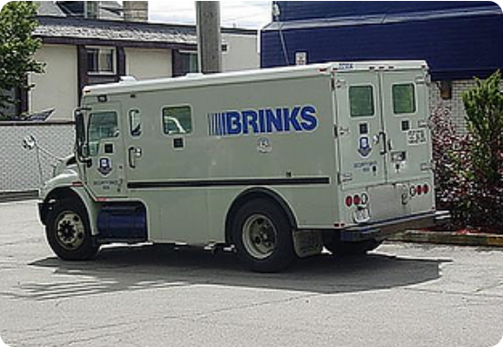
SPEAKER 2 · TRANSPORT SECURITY
HTTP vs. HTTPS: Flatbed vs. Armored Truck
Highway Threat Defense
HTTP (Flatbed): Plaintext visible to roadside onlookers.
HTTPS (Armored): Encrypted dual-key digital vault lock.
Tamper-Proof: Only warehouse destination possesses key.

Slide 9

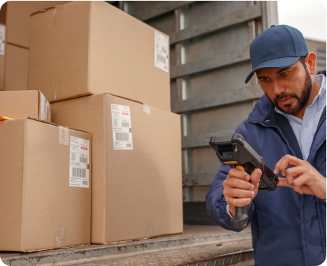
SPEAKER 2 · OUTCOME DISPATCH
Handheld Scanner Notifications
2xx
Delivered
Handed over and signed successfully.
3xx
Rerouted
Forwarded to new regional facility.
4xx
Shipper Error
Invalid address or missing delivery PIN.
5xx
Depot Error
Sorting machinery internal breakdown.

Slide 10
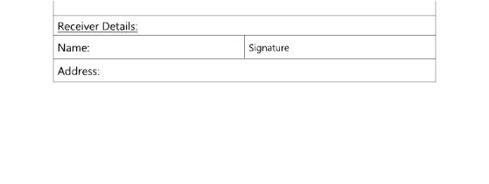

SPEAKER 2 · DELIVERY SCENARIOS (PART A)
Registration & Authorization
201 Created
401 Unauthorized
Account Created
Wrong Password
New parcel registered in warehouse records.
Door delivery PIN verification failed.

Slide 11
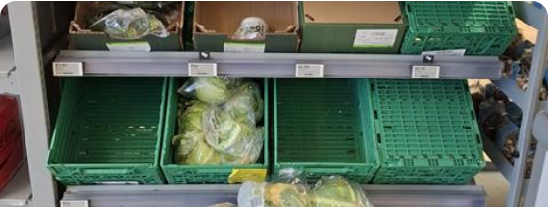
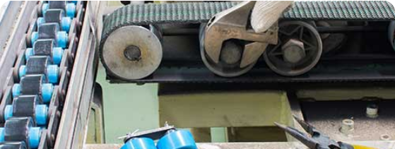
SPEAKER 2 · DELIVERY SCENARIOS (PART B)
Missing Items & Facility Crashes
404 Not Found
500 Server Error
Product Not Found
Server Crash
Requested barcode absent from depot shelves.
Sorting facility conveyor belt breakdown.

Slide 12
ARCHITECTURE TAKEAWAY
The Truck Moves Cargo.
The Barcode Enables Scale.
HTTP carries the packages, REST standardizes the shipping labels, and status codes confirm final delivery.

Slide 13






Image Sources
https://img.magnific.com/premium-vector/courier-brings-packages-with-van-illustration_338371-73.jpg
Source: www.magnific.com
https://www.movexwarehousing.com/assets/img/industry/industry-3.png
Source: www.movexwarehousing.com
https://images.presentationgo.com/2025/05/ecommerce-shopping-cart-concept.jpg
Source: www.presentationgo.com
https://ajeets.com/_next/image?url=https%3A%2F%2Fajeets.s3.ap-south-1.amazonaws.com%2Fseed_dbo.master_web_generator-industries%2F63779d3f-5e67-48cd-9110-0bfaf5a3114b-1745587009080.webp&w=3840&q=75
Source: ajeets.com
https://www.scopelink.com.au/wp-content/uploads/2026/04/What-Is-a-Barcode-System-and-How-Does-It-Work-in-a-Warehouse.jpg
Source: www.scopelink.com.au
https://omegaecycles.com/wp-content/uploads/2024/12/Contact.jpg
Source: omegaecycles.com

Slide 14






Image Sources
https://static.wixstatic.com/media/8cc648_1d65c822426a4ba580137b121ff7b2ce~mv2.png/v1/fill/w_319,h_216,al_c,q_85,usm_0.66_1.00_0.01,enc_avif,quality_auto/0ff54a_7e91241e3771464d866507435f4c3a1b_.png
Source: www.texassecurityguardunion.com
https://www.zebra.com/content/dam/zebra_dam/global/zcom-web-production/web-production-photography/web005/tandl-photography-website-post-courier-delivery-hero-16x9-3600x2025.jpg.imgo.jpg
Source: www.zebra.com
https://source.cocosign.com/images/receipt/delivery/delivery_1.jpg
Source: cocosign.com
https://butterflymx.com/wp-content/uploads/2025/10/commercial-keypad-access-control-system-1-700x466.webp
Source: butterflymx.com
https://dmrqkbkq8el9i.cloudfront.net/Pictures/480xany/8/5/8/386858_coopavailabilityshortagesemptysupermarketshelves3_472512_crop.jpg
Source: www.thegrocer.co.uk
https://mechsol-ltd.co.uk/wp-content/uploads/2022/07/Production-line-breakdown-AdobeStock_247803272-2.jpg
Source: mechsol-ltd.co.uk

